Slide 1

Module 8: Migrating ETL Mappings and Workflows
0/5
Analytics: Advanced Data Warehouse Developer
Notes:
Time: Lecture: 15 – 25 minutes; Labs: 30 – 40 minutes
Intent: To learn to migrate ETL mappings and workflows from one environment to another environment.
Flow: Describe the development migration process; describe the export process; describe the import process; list the various options to resolve conflicts during the import process
Key Terms:
Export
Import
Objects
Conflicts
8

Slide 2
Module Objectives
After completing this module you will be able to:
  Migrate extraction, transformation, and loading (ETL) mappings and workflows from one environment to another environment
  Export Informatica objects
  Import Informatica objects
Why you need to know:
  You need to know how to migrate a mapping or workflow developed and tested in one environment to another environment
Notes:
Each objective and “why you need to know” should be stated aloud.

Slide 3
Development Migration
Use Informatica export and import process to propagate Informatica mappings and workflows built and tested in one environment to another environment
Use Informatica client tools to export and import the Informatica objects
  Informatica Designer
  Informatica Workflow Manager
  Informatica Repository Manager
Notes:
This slide provides an overview of how Informatica’s export and import processes can be used to migrate mappings and workflows. In addition to propagating repository changes from one environment to another environment, the export and import processes can be used to accomplish the following tasks:
Archiving repository contents temporarily before removing permanently from the repository
Sharing repository contents with a third party. It is easier to share using an XML file format
Searching and replacing property names in an entire repository object. For example, if a port name is changed and you want to search and replace that port name in the entire mapping, it is easier to perform this change in an XML file than manually editing the mapping.
Copying metadata between repositories that you cannot connect to from the client
8

Slide 4
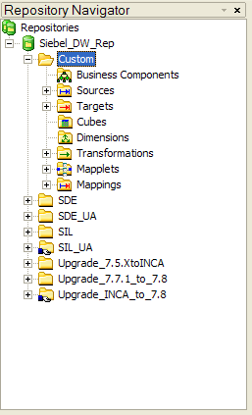
Exporting and Importing Mapping Objects
Use Informatica Designer or Repository Manager to export and import the following objects:
  Sources
  Targets
  Transformations
  Mappings
  Mapplets
Notes:
Exporting or importing a mapping also exports/imports sources, targets, transformations, and mapplets contained within that mapping.

Slide 5
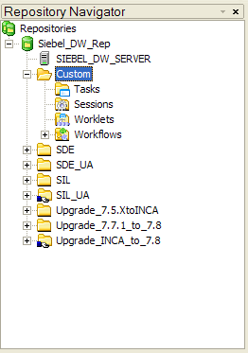
Exporting and Importing Workflow Objects
Use Informatica Workflow Manager or Repository Manager to export and import the following objects:
  Sessions
  Tasks
  Worklets
  Workflows
Notes:
Exporting or importing a workflow also exports/imports sessions, tasks, and worklets contained within that workflow.
8

Slide 6
Export Process—Steps
0/3
1. Select the export object
2. Specify export options
3. Verify export results
Notes:
This is a structuring slide. Do not teach the steps or concepts here because the following slides cover them in detail.

Slide 7
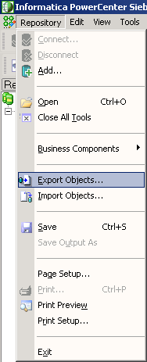
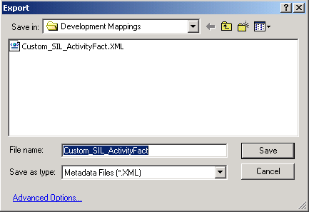
1. Select the Export Object
1/3
Save the selected export object to a XML file
The default XML file name takes the mapping name
Notes:
This slide describes the process to export a mapping. Use the Informatica Repository Manager if you want to export more than one object.
8

Slide 8
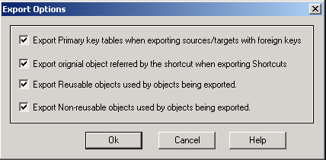
2. Specify Export Options
2/3
Select the dependent objects that need to be exported along with the objects being exported
All dependent objects are selected by default
Click to choose which dependent objects to export
Notes:
Point out that you can export or import an object with or without its dependent objects.

Slide 9
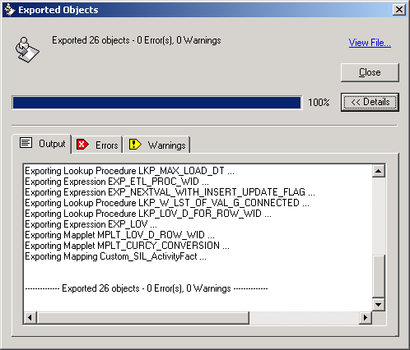
3. Verify Export Results
3/3
Review the summary results before finalizing the export process
The contents of the XML file can be viewed
Notes:
The Informatica Client displays export status in the Exported Objects dialog box.
8

Slide 10
Import Process—Steps
0/4
1. Select the import file
2. Select the import objects
3. Resolve conflicts
4. Verify import results
Notes:
This is a structuring slide. Do not teach the steps or concepts here because the following slides cover them in detail.

Slide 11
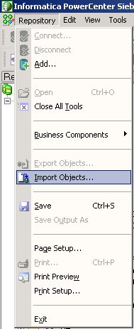
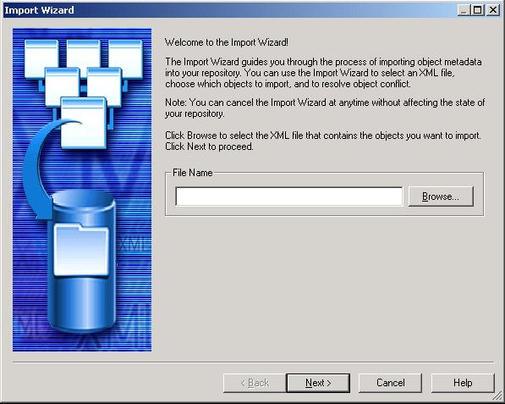
1. Select the Import File
1/4
Import objects from the XML files created during the export process
Import Wizard
Browse to locate the XML file
Notes:
This slide details the process to import objects from an XML file.
8

Slide 12
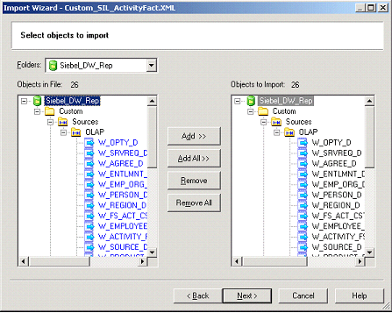
2. Select the Import Objects
2/4
Specify the objects to import from the import file in the Import Wizard
  The Add All option imports all the objects in the import file
Notes:
It is possible to exclude some objects listed in the XML file. For example, if you want to prevent overwriting an existing transformation in the imported folder, you can exclude those objects from getting imported.

Slide 13
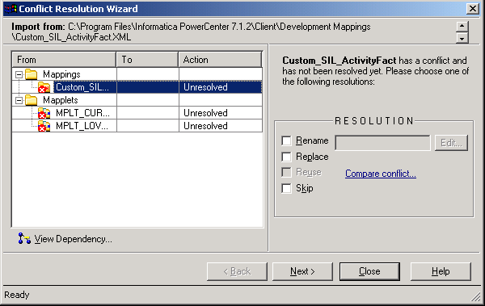
3. Resolve Conflicts
3/4
In the case of any conflicts, the import wizard opens the conflict resolution wizard
Resolve object conflicts as they appear
  Resolve all the conflicts to complete the import operation
Conflict resolution options
Click to compare conflicting objects
Notes:
If the repository folder already contains an object with the same name, you can choose to rename, replace or reuse that object.
8

Slide 14
3. Resolve Conflicts Continued
3/4
Use one of the following options to resolve conflicts
Resolution Name | Description | Availability
Rename | Change the object name when copying it to the target folder | When an object with the same name exists in the target folder
Replace | Replace the existing object in the target folder | When copying to another folder in the same repository or another folder in a different repository and an object with the same name exists in the target folder
Reuse | Use the existing object in the target folder | When a reusable object exists in the target folder
Skip | Skips copying the object | When an object with the same name exists in the target folder
Notes:
Not every resolution option is available for every conflicting objects. Some resolution options may not be available depending on the object type and conflicts.
It is possible to resolve some object conflicts by creating rules that apply to a set of objects rather than manually resolving each one of them.

Slide 15
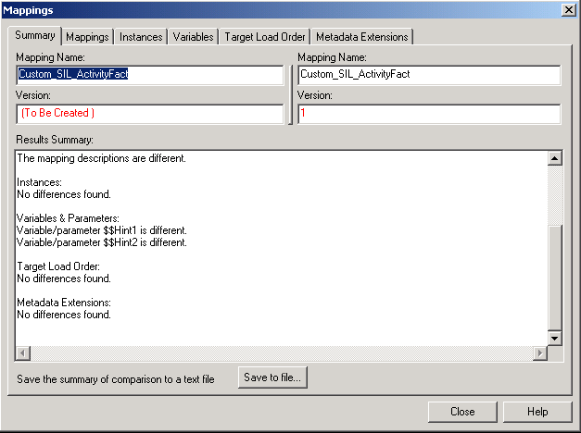
3. Resolve Conflicts Continued
3/4
Compare conflicting objects in the XML file and target repository
Save the comparison as a text or HTML file
Notes:
The conflicting objects can be compared and saved to an XML file for later analysis.
8

Slide 16
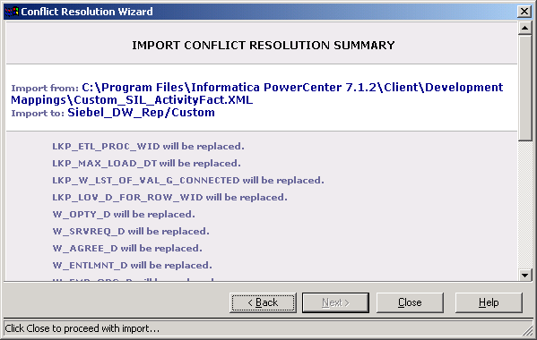
4. Import Summary
4/4
Review the results before finalizing the import process
  Errors and warnings are designated by colored text
Notes:
The import is not complete until this step and can be backed out if necessary at this point in time. Clicking the Close command button completes the import process.

Slide 17
Summary
This module showed you how to:
  Migrate extraction, transformation, and loading (ETL) mappings and workflows from one environment to another environment
  Export Informatica objects
  Import Informatica objects
Notes:
This slide presents a summary of the topics covered in the module.
8

Slide 18
Lab
In the lab you will:
  Perform steps to migrate ETL mappings and workflows from one environment to another environment
Notes:
Labs and Troubleshooting:
In this lab, students are asked to copy a mapping from SDE to Custom folder and perform export and import of that mapping.

